Slide 1
OHIO IMPROVEMENT PROCESS: THE 5-STEP PROCESS
Notes:
Welcome. Today we will be learning about the 5-Step Process with the Ohio Improvement Process.

Slide 2
OBJECTIVES
TEACHERS WILL:
Learn about the Ohio Improvement Process.
Learn how to use the 5 Step Cycle of Inquiry and how it is situated within the Ohio Improvement Process.
Learn about the components that make an efficient TBT.
Notes:
A brief explanation of the objectives of this Professional Development will happen here.
About OIP
About the 5-Step Process as part of the OIP
About what makes a TBT function

Slide 3
WHY THE OHIO IMPROVEMENT PROCESS?
ODE has revised it’s guidance to school districts regarding Continuous Improvement resulting in the Ohio Improvement Process. The revisions occurred because of:
Changes in technology
New learning about the effective use of relevant data
More concrete knowledge about what works and how to distribute leadership in districts and schools to improve instructional practice and student performance.
www.education.ohio.gov
Notes:
I will give information regarding how and why the OIP came about.
Technology
New learning about data
More knowledge about distributed leadership.

Slide 4
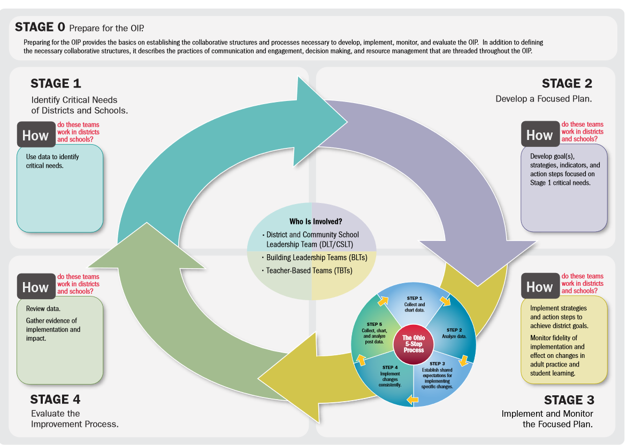
What is the Ohio Improvement Process?
www.education.ohio.gov
Notes:
I will more fully explain the OIP.
Stage 0-Prepare
Stage 1-Identify Needs
Stage 2-Develop a Plan
Stage 3-Implement and Monitor the Plan (I will focus attention on Stage 3 and how it contains the 5-Step Process.)
Stage 4-Evaluate

Slide 5
WHO IS PART OF THE OIP?
District Leadership Team
Building
Leadership Team
Teacher Based Team
Teacher
Every person in the district is part of the OIP.
Notes:
I will discuss what the constituency of the OIP is and how it each team and person is responsible to the others.

Slide 6
WHAT ARE THE ROLES OF THESE GROUPS?
District Leadership Team
Building Leadership Team
Teacher Based Team
Train TBT in 5-step process
Asses quality of TBT implementation
Use BLT data to provide support
Collect Data
Analyze results
Choose a strategy and provide instruction
Assess
Collect Data
(The 5-step Process)
Monitor TBT
Uses the data to provide supports for TBT
Provide TBT information for DLT
www.education.ohio.gov
Notes:
I will discuss the role of each team (DLT, BLT, and TBT) and how their responsibilities.

Slide 7
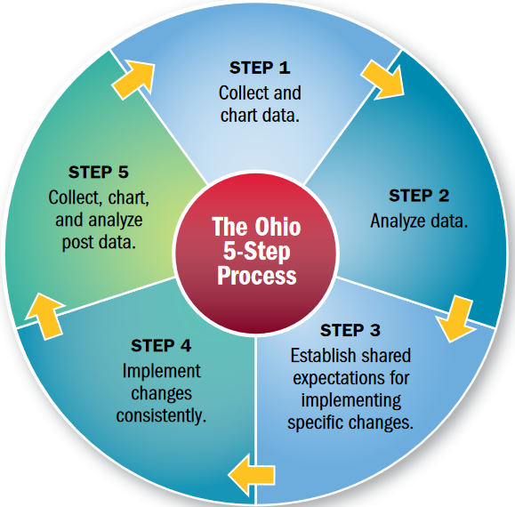
The 5-Step Process of Inquiry:
This is embedded in step 3 of the OIP and is completed by TBTs.
www.education.ohio.gov
Notes:
This is the 5-Step Process that is embedded in Stage 3 of the Ohio Improvement Process. This is the work of TBTs. BLTs can also use the 5-Step Process, but the data that is used is data they receive from TBTs.

Slide 8
The 5-Step Process of Inquiry:
Another view:
Teacher Based Teams will:
Collect Data
Analyze Student Work
Establish shared strategies for change
Implement changes
Collect, chart, and analyze data
Notice how step 1 and step 5 are similar. The beginning and the end of the cycle are interchangeable.
www.education.ohio.gov
Notes:
Here is another view of the 5-Step Process. It is a cyclical process where the goal is to increase student learning.
As we continue on, we will learn how to implement each step.

Slide 9
LET’S GET STARTED When tbt’s meet, you will record your minutes on the meeting agenda and minutes template. (SEE HANDOUT.)
This is what will be turned in to the BLT upon completion.
www.education.ohio.gov
Notes:
You will complete the TBT 5-Step Process Template during your TBTs.

Slide 10
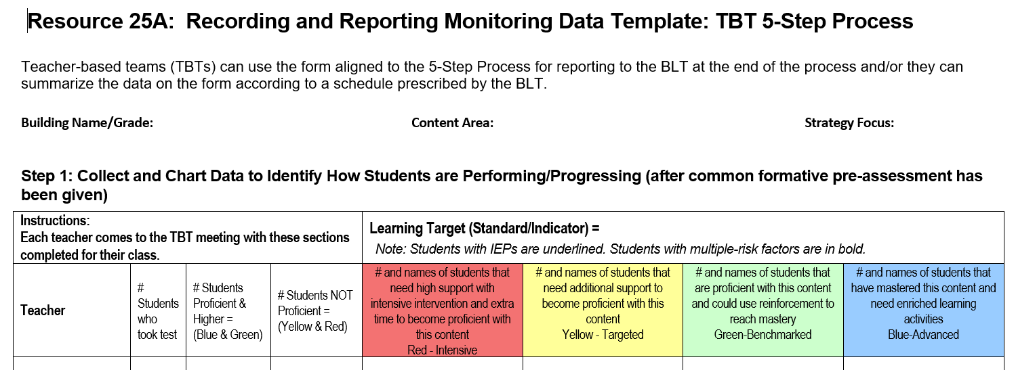
Let’s get started You will also UsE this RECORDING AND REPORTING MONITORING DATA TEMPLATE DURING THE TBT PROCESS. (SEE HANDOUT.)
www.education.ohio.gov
Notes:
This Recording and Reporting Monitoring Data Template will be used to record your data.

Slide 11
Step 1 Data Collection: Collect and chart data to identify how students are performing/progressing
During the first TBT meeting, you will decide what will be the focus of your 5-step process cycle.
This should reflect one of your teaching standards.
This should be a topic you think is an area in need of improvement.
Give a common pre-assessment to all students.
www.education.ohio.gov
Notes:
Before you can fill out the 5-Step Process Template, you will need to decide what topic you wish to focus on.
Choose a standard that is need of improvement
Choose and administer a common pre-assessment to all students.

Slide 12
Step 1 Data Collection: Collect and chart data to identify how students are performing/progressing
An example focus could be Kindergarten LA:
Associate the long and short with common spellings for the 5 major vowels.
Notes:
Here is an example of a topic of focus.

Slide 13
Step 1 Data Collection:
The pre-assessment could look like this:
Notes:
This is an example pre-assessment. The assessment needs to match your focus and standard.

Slide 14
Step 1 Data Collection: Take 5 minutes
In your TBT group, discuss what you could use a focus for your 5-step cycle and what assessment you would use.
Notes:
Within your TBT, discuss how you can choose a focus, what that focus will be, and what assessment you could use.

Slide 15
Step 1 Data Collection: Collect and chart data to identify how students are performing/progressing
The next meeting of your TBT will rely on the following:
Data is ready and brought by all teachers.
Item analysis is complete.
Includes students tested/proficient and not proficient.
Subgroup data is reported.
Determine benchmark score for grouping criteria.
www.education.ohio.gov
Notes:
The second meeting of your TBT will to analyze the data you have collected. When you report to your TBT you will need to have charted your data and determined who is proficient or not proficient within subgroups.

Slide 16
Step 1 Data Collection: Take 5 minutes
In your TBT group, discuss what criteria you would use to determine levels of proficiency.
Notes:
In your group, decide how you will determine proficiency. Be sure to divide into levels that will correspond to instructional strategies that you will employ. There may a rubric you use to determine levels, but if not, how will determine proficiency levels?

Slide 17
Step 1: Data Collection
Chart you data prior to this next meeting on this Recording and Reporting Data Template.
www.education.ohio.gov
Notes:
This is the Recording Data Template. Add your information. Notice that on this form, students in subgroups (IEP and Multi-risk factors) are bold-typed or underlined. This allows you to see subgroup information.

Slide 18
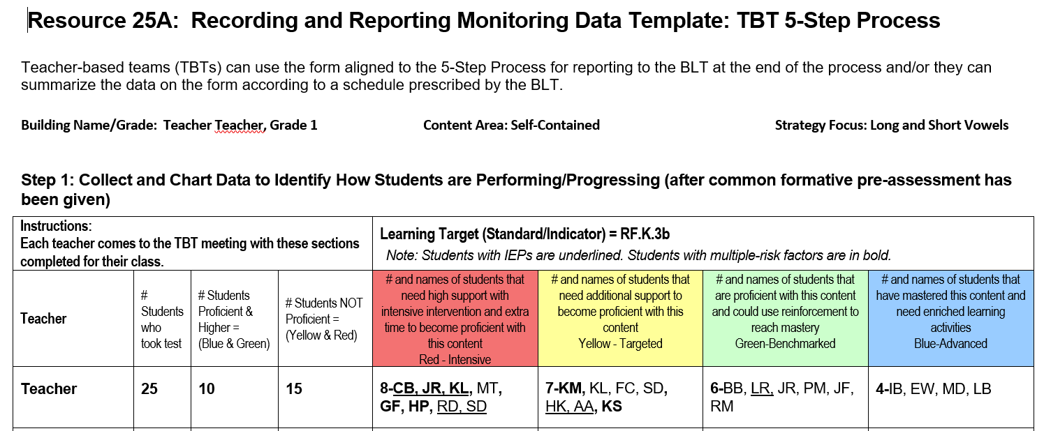
Step 1: Data Collection
A completed example:
www.education.ohio.gov
Notes:
This is an example of a completed Recording Data Template for Step 1.

Slide 19
Step 1 Data Collection
At the TBT meeting, aggregate all teacher’s data onto the TBT 5-step Process form.
www.education.ohio.gov
Notes:
After comparing all teachers data on the recording form, generally summarize the information on this TBT 5-Step Process Template.

Slide 20
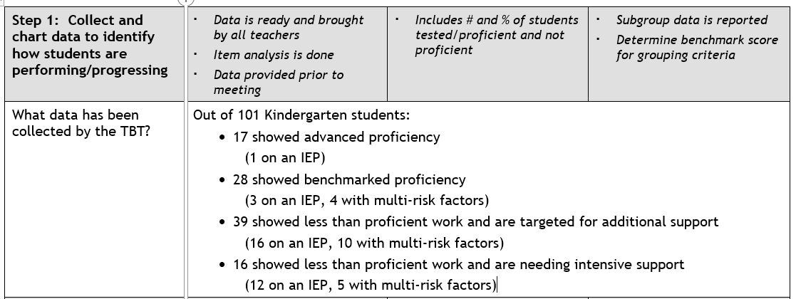
Step 1 Data Collection
www.education.ohio.gov
Notes:
Here is an example of a complete TBT 5-Step Process Template with all teachers’ information included.

Slide 21
Step 2 ANALYZE STUDENT WORK SPECIFIC TO THE DATA ask yourselves these questions:
What did students do well and why?
What did students not do well on and why?
Were there common errors, misconceptions, or urgent needs?
Are there patterns or trends?
Prioritize needs.
www.education.ohio.gov
Notes:
In Step 2, you will ask yourself the questions listed.
Look at your compiled data and analyze what the common errors, misconceptions, etc.
Did the students to very well on a certain part? Were there weaknesses on certain sections?
Do you notice anything that stands out?
What will be the most important next step to promote student growth?

Slide 22
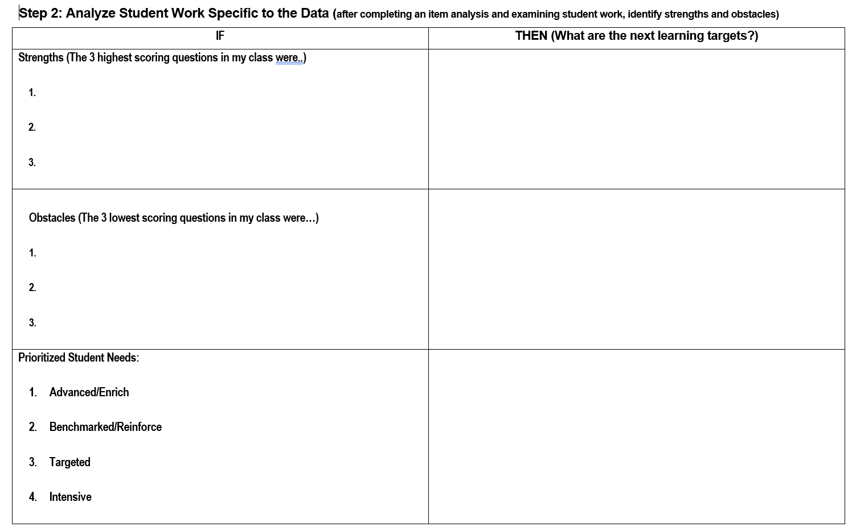
www.education.ohio.gov
Notes:
This is the part of the Recording Data Template you will use to record the students’ strengths and weaknesses. Also determine leveled needs for student groupings.

Slide 23
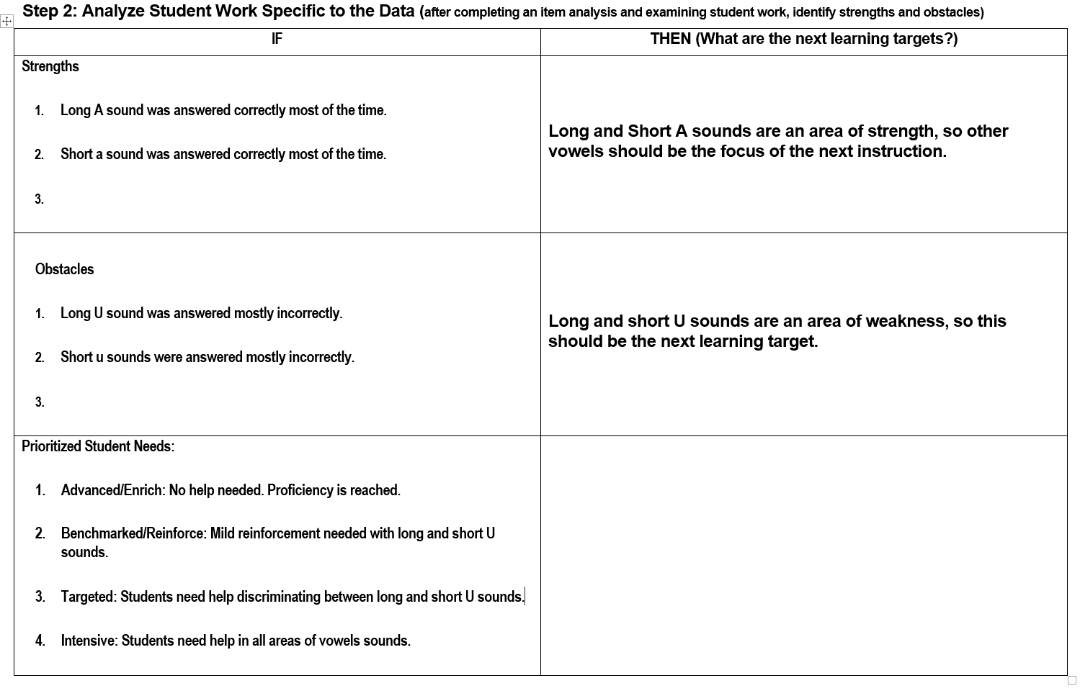
www.education.ohio.gov
Notes:
Here is a completed example of Recording Data Template for step 2.

Slide 24
Step 2 ANALYZE STUDENT WORK SPECIFIC TO THE DATA Take 5 minutes
In your TBT group, use the strengths and weaknesses we just discussed and report these using the TBT 5-Step Template as seen here.
www.education.ohio.gov
Notes:
In your TBT group, fill in your summary of strengths and weaknesses, patterns and trends on the is TBT 5-Step Template.

Slide 25
Step 3 Establish shared expectations for implementing specific changes in the classroom
How will students be grouped for instruction?
What differentiated strategies will be used?
When will this instruction happen?
What support/training in a specific strategy is needed?
Determine length/frequency of instruction.
www.education.ohio.gov
Notes:
Now it is time to determine how to implement changes in the classroom. You will need to answer these questions according to what your team decides.
Grouping of students that is most beneficial—ability level, mixed ability, etc.
Differentiated strategies (Be sure these are strategies and not activities. Also, be sure your strategies are researched based. Will you use Marzano or some other research-based teaching strategy?)—guided practice, identifying similarities and differences, setting targets, providing feedback, cooperative learning, etc. Then you can decide upon student activities like picture sorts, flash cards, etc.
Time of instruction—during core class, during intervention time, during enrichment time, after-school tutoring.
Support could be PD, coaching, or co-teaching
Frequency—How many minutes/days per week.

Slide 26
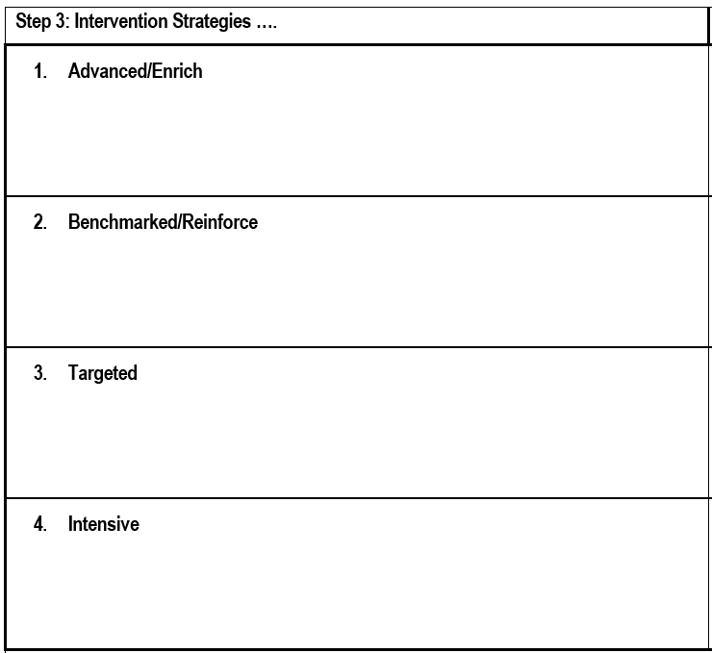
Step 3
www.education.ohio.gov
Notes:
This is the section of the Data Recording Template you will use to determine intervention strategies. Notice they are leveled by proficiency groupings.

Slide 27
Step 3 Establishing shared expectations for implementing specific changes in the classroom: Take 5 minutes
In you TBT group, fill out the intervention strategies you would use for the groupings students as listed on the previous screen and your handout.
Notes:
In your TBT group, determine interventions you could use for the different groupings of students. . Be sure to use research-based strategies.

Slide 28
Step 3 Establishing shared expectations for implementing specific changes in the classroom:
Classroom observations may occur.
Demonstrations
Co-teaching
Modeling
Notes:
In this step, teachers who are familiar with the strategies chosen may demonstrate it for the other teachers through classroom observations.
This may also take place in the form of modeling and co-teaching.

Slide 29
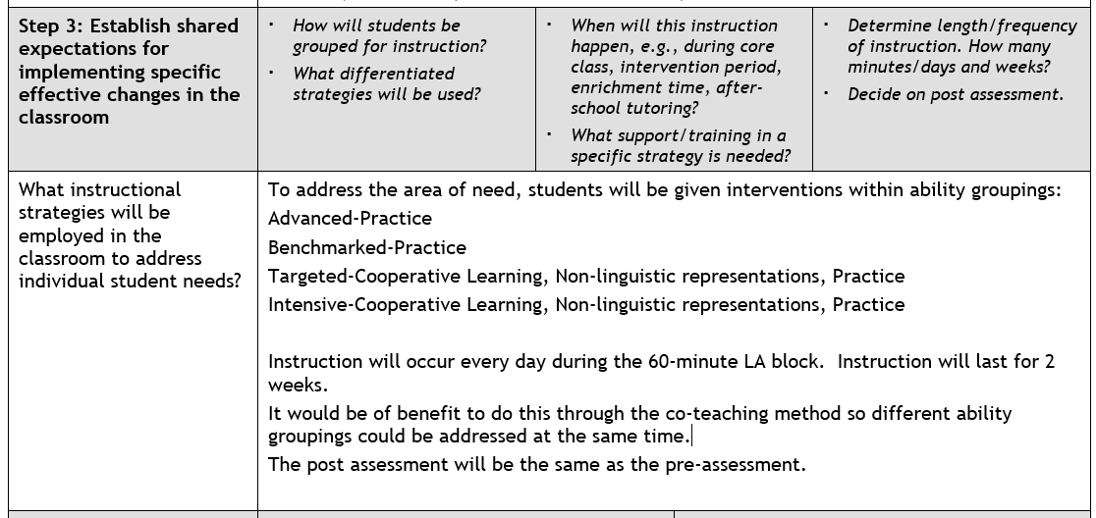
Step 3 a completed step 3 tbt reporting form:
www.education.ohio.gov
Notes:
This is an example of summarized decisions about Step 3 on the TBT 5-Step Template.

Slide 30
Step 4 IMPLEMENT CHANGES consistently across the classroom
What will be observed in the classrooms?
What will the teacher be doing?
What will the students be doing?
www.education.ohio.gov
Notes:
Step 4 has to do with implementing the decided upon changes consistently. If the changes are not consistent, there will not be a way to determine if the change was beneficial to help fix the problem.
If someone walked into your classroom, would they see the agreed upon changes?
The teacher should be implementing the agreed upon strategies.
The students will be completing the agreed upon activities.

Slide 31
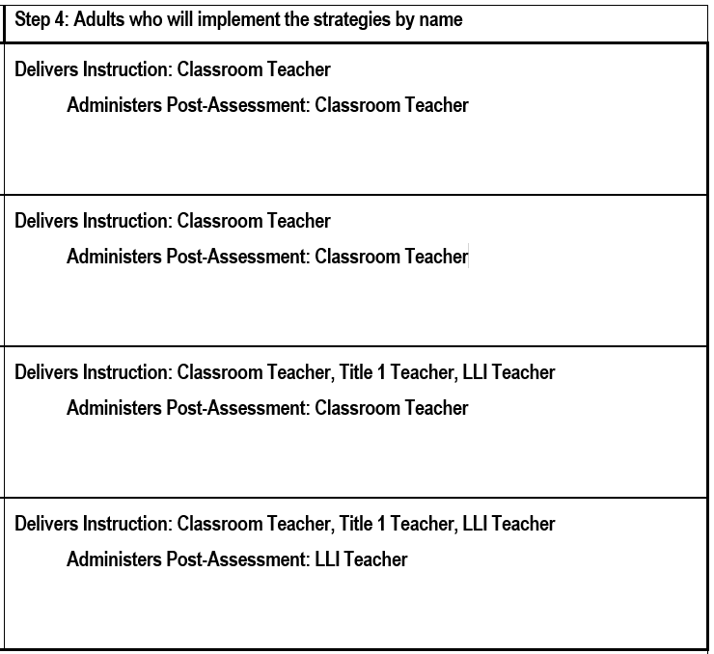
Step 4
www.education.ohio.gov
Notes:
This is an example of completed Step 4 on the Recording Data Template.

Slide 32
Step 4 IMPLEMENT CHANGES CONSISTENTLY ACROSS ALL CLASSROOMS Take 5 minutes
In you TBT group, fill in the TBT 5-Step Process Template aggregating the data from the implementation/assessment form.
www.education.ohio.gov
Notes:
In your TBT group, fill out this TBT 5-Step Template for Step 4 by utilizing and expanding on the information in the implementation form.

Slide 33
Step 5 Collect, chart, and analyze post assessment data
Did you notice this is similar to Step 1?
This creates the CYCLE of inquiry.
Notes:
The 5-step process is cyclical with step 1 and step 5 being similar.

Slide 34
Step 5 Collect, chart, and analyze post assessment data
Everyone comes with assessments scored and data ready.
Best practices shared from classroom teachers with high student results on post-test.
Include pre data and post data for all students (and any subgroups).
Use same chart from Step 1 to collect/record data
www.education.ohio.gov
Notes:
During step 5, data is again analyzed. The difference is that both pre and post assessment data is available . This allows for determination of the effectiveness of strategies. Also, those teachers who had high-scoring student post assessments can share what worked for them.

Slide 35
Step 5 Collect, chart, and analyze post assessment data
www.education.ohio.gov
Notes:
This is an example Step 5 Recording Data Template.
Notice the inclusion of pre and post assessment data.

Slide 36
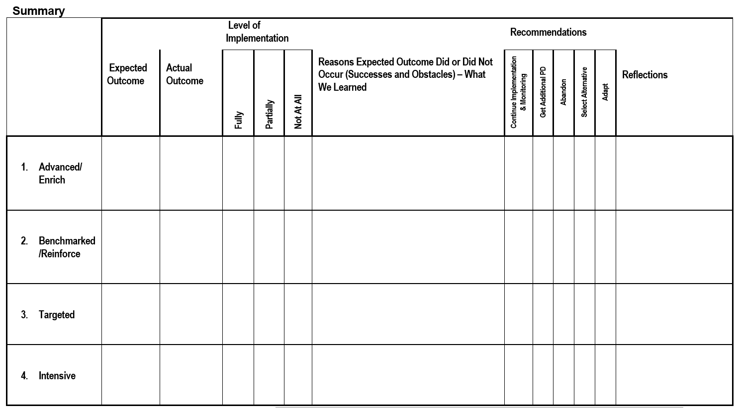
Collect, chart, and analyze post assessment data
www.education.ohio.gov
Notes:
This is a form for the analysis of the teacher implementation and other reflections about the process as part of Step 5 in the Recording Data Template. This should be completed using all of the information gained during this cycle. This allows teachers to see if implementation was done to the level expected, what obstacles and successes were, and if teachers feel they need additional help.

Slide 37
Step 5 Collect, chart, and analyze post assessment data
www.education.ohio.gov
Notes:
Finally, this is the TBT Reporting form where the information gathered in step 5 will be aggregated. Once complete, this form will be passed on to the BLT.

Slide 38
Step 5 Collect, chart, and analyze post assessment data
After all data is compiled and analyzed, ask yourself:
What strategies and practices worked well?
What did not work?
What did we do to amend our goals when needed?
Do we, as staff, need assistance in any area to make our teaching more effective?
Notes:
When the cycle is complete, take a good look at the results and the practices used to get those results.
Decide what was effective, what you did to make things work better, and if you need any PD or support to continue forward.

Slide 39
And that’s the 5-step Process. Questions? Thanks for your attention.
www.education.ohio.gov
Notes:
During step 5, data is again analyzed. The difference is that both pre and post assessment data is available . This allows for determination of the effectiveness of strategies. Also, those teachers who had high-scoring student post assessments can share what worked for them.

Slide 40
REFERENCES
Green, R.L. (2017). Practicing the Art of Leadership: A Problem-Based Approach to Implementing the Professional Standards for Educational Leaders (5th ed.). New York, NY: Pearson Ed.
Ohio Department of Education, Ohio Improvement Process (OIP) Guide. (2012). Facilitating
districtwide improvement in instructional practices and student performance. Retrieved
September 22, 2017 from www.ohio.gov.
Resource 21C, TBT 5-Step Process Meeting Agenda and Minutes Template. (2016). Retrieved
September 22, 2017 from www.ohio.gov.
Resource 25A, Recording and Reporting Monitoring Data Template: TBT 5-Step Process. (2016). Retrieved
September 22, 2017 from www.ohio.gov.

Slide 41
Reflection on Leadership Theory
In Practicing the Art of Leadership, Green (2017) states that “the principal should assume the role of instructional leader and be willing to be held accountable for the academic achievement of all students” (p. 236). This is a serious charge and momentous undertaking for one person. As principal, I will have a large task on my hands.
As Green (2017) continues, to fulfill this role, the principal needs to “establish learning communities, build capacity for change, and identify the positive and negative forces that impact the change process (p.236). As principal, I must work with others by preparing them to change their way of looking at certain aspects of education.
An action that I can take to help with the change process includes employing the participatory style of leadership. By allowing others such as teachers, parents, and community members to participate in leadership, this helps build the capacity for change. When all stakeholders are invited to participate, the change will be more widely accepted than if a directive were to come from the top down (Green, 2013). By having teachers participate in DLTs, BLTs, and TBTs, they become part of the leadership and are, therefore, more accepting of the changes that need to occur.

