Slide 1
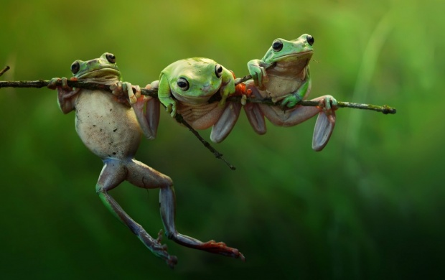
It’s Mine
By Leo Lioni
On the island lived a family with three quarrelsome frogs named Milton, Rupert, and Lydia. They quarreled and quibbled all the time.
https://www.youtube.com/watch?v=sEYNvhrgZv0

Slide 2
WORD OF THE WEEK: Quarreled
After reading the passage, what do you think quarreled means?
TURN AND TALK

Slide 3
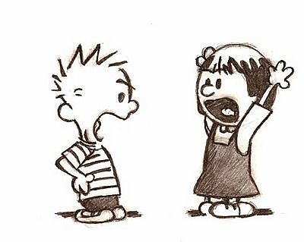
WORD OF THE WEEK
Quarreled
To have a disagreement over something

Slide 4
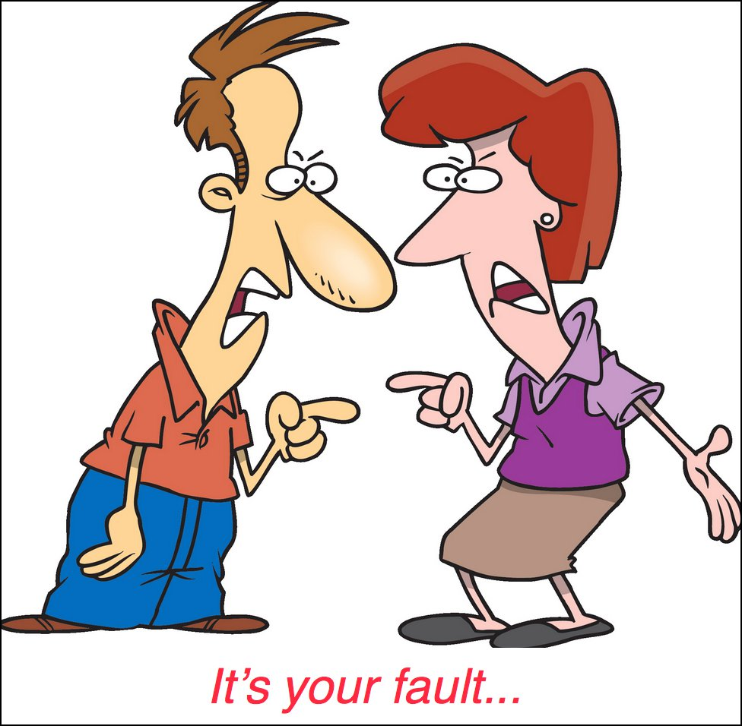
WORD OF THE WEEK: Quarreled
Think of a time when…
you quarreled with someone. What did you quarrel about?
TURN AND TALK

Slide 5
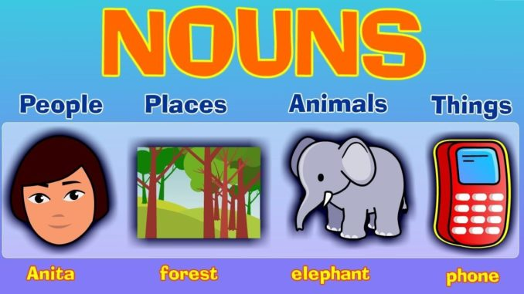
WORD OF THE WEEK: Quarreled
Is quarrel a noun or a verb?
Can it be both?
OR
TURN
AND
TALK

Slide 6
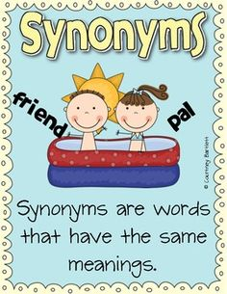
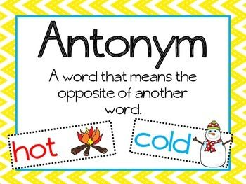
WORD OF THE WEEK: Quarreled
What are some synonyms and antonyms of quarreled?
Cooperated: The men cooperated to get the job done.
TURN
AND
TALK
Argued: The girls argued about who was right.

Slide 7
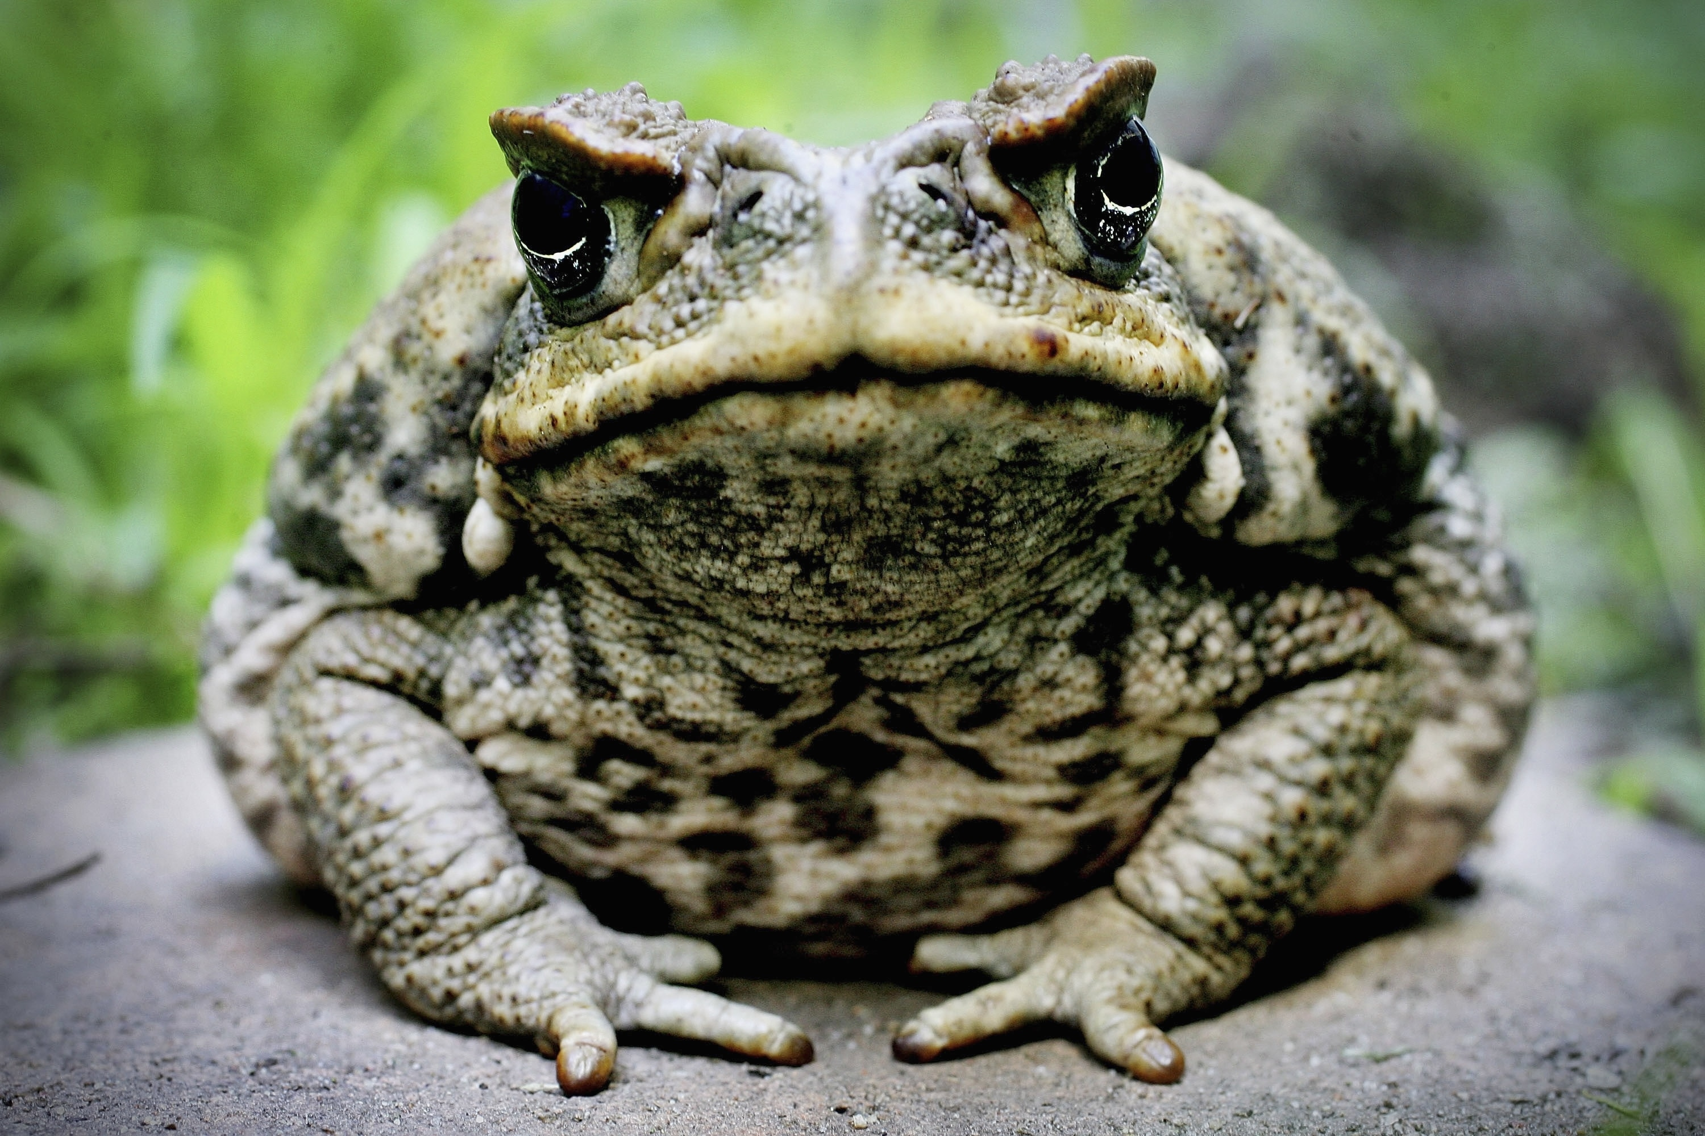
Can you find the synonym in this passage?
One day a large toad appeared before them. “I live on the other side of the island,” he said “but I can hear you shouting, ‘It’s mine!! It’s mine! It’s mine!’ all day long. There is no peace because of your endless bickering. You can’t go on like this.”

