Slide 1
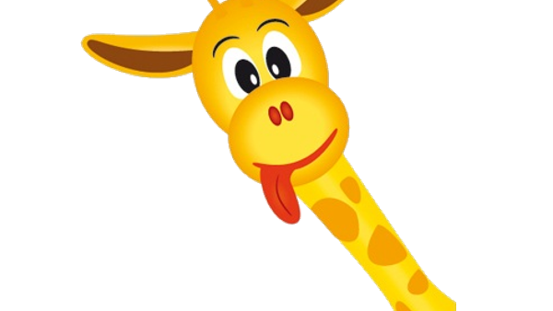
Entranced
Giraffes Can’t Dance
https://www.youtube.com/watch?v=Zzb5Acl-n70
Gerald felt so wonderful
His mouth was open wide.
“I am dancing! Yes, I’m dancing!
I AM DANCING!” Gerald cried.
Then, one by one, each animal
who‘d been there at the dance
arrived while Gerald boogied on
And watched him, quite entranced.

Slide 2
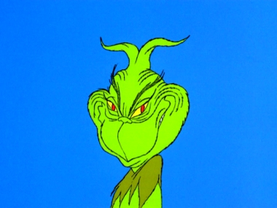
EXTRA! EXTRA!
Gerald swallowed bravely
As he walked toward the floor
But the lions saw him coming,
And they soon began to roar.
“Hey, look at clumsy Gerald,”
the animals all sneered.
“Giraffes can’t dance, you silly fool!
Oh, Gerald, you’re so weird.”
Do you notice anything?
REMINDER:

Slide 3
WORD OF THE WEEK: Entranced
After reading the passage, what do you think the word “entranced” means?
TURN AND TALK

Slide 4
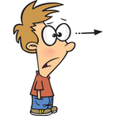
WORD OF THE WEEK: Entranced
Here’s a Hint:
In what way is this boy seeing ?

Slide 5
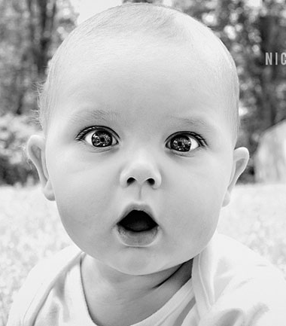
ENTRANCED:
Filled with delight or wonder.

Slide 6
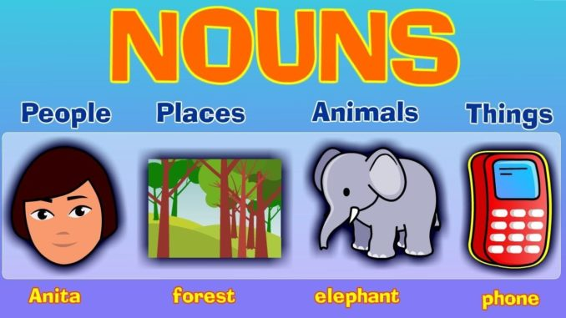
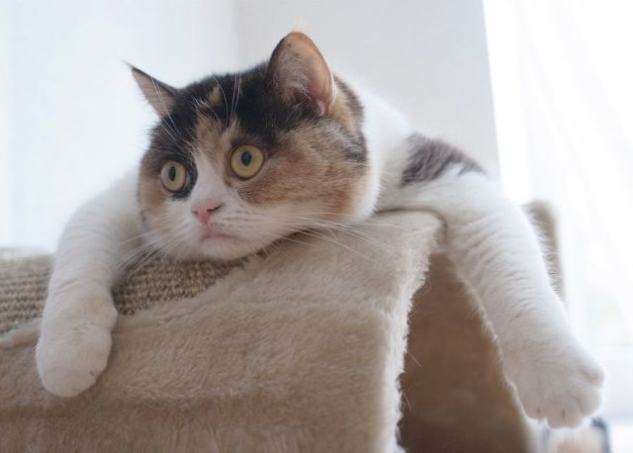
WORD OF THE WEEK: Entranced
Is entranced a noun or a verb?
The girl entranced the boy with her beauty.
OR
TURN
AND
TALK

Slide 7
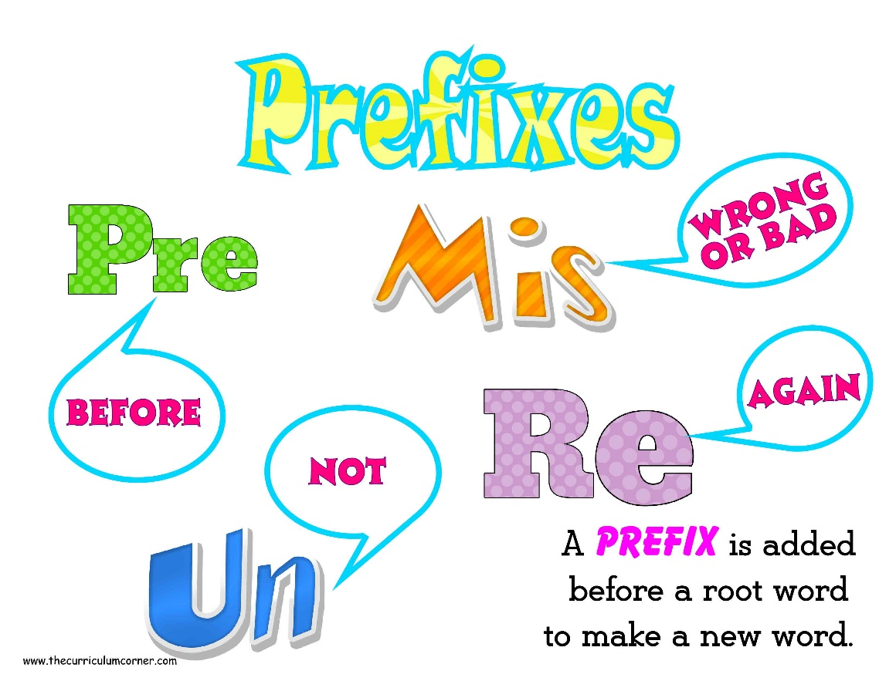
Word Parts
Prefixes are added to the beginning of words and change their meanings.
en = “in”
encourage = “wrongly understood”
Can you think of other words that start with “en”?
TURN AND TALK

