Slide 1
PBIS
Positive behavioral intervention and supports

Slide 2
Gov. Kasich signed HB 318 in August 2018, with an effective date of Nov. 2, 2018. Broadly, this act:
• Specifies requirements for the implementation and training of Positive Behavioral Interventions and Supports and other social-emotional programs for students;
• Outlines parameters for the suspension and expulsion of students, particularly for students in grades prekindergarten through grade 3;
• Provides grant funding for school safety training and school climate.

Slide 3
What is PBIS?
“Positive Behavioral Intervention and Supports (PBIS) is an
evidence-based
three-tiered framework
for improving and integrating data, systems, and practices affecting student outcomes every day.”

Slide 4
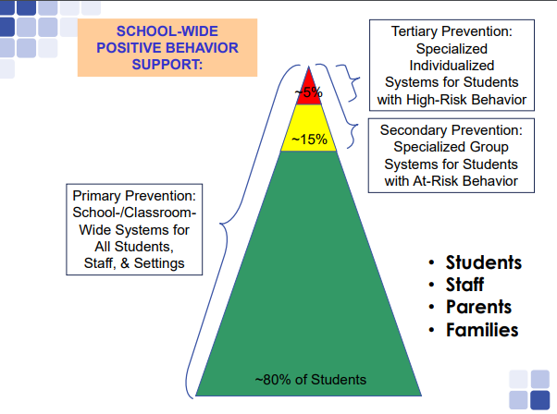

Slide 5
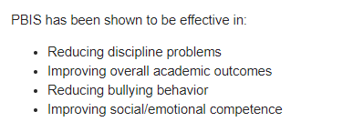

Slide 6
Behavioral Change…
Is an instructional process.
We change student behavior by changing adult behavior.

Slide 7
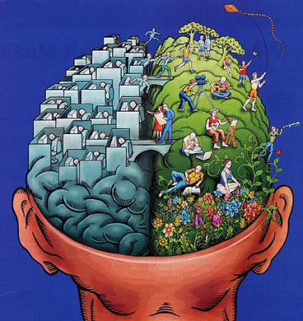
Trauma-Brain vs. Learning-Brain

Slide 8
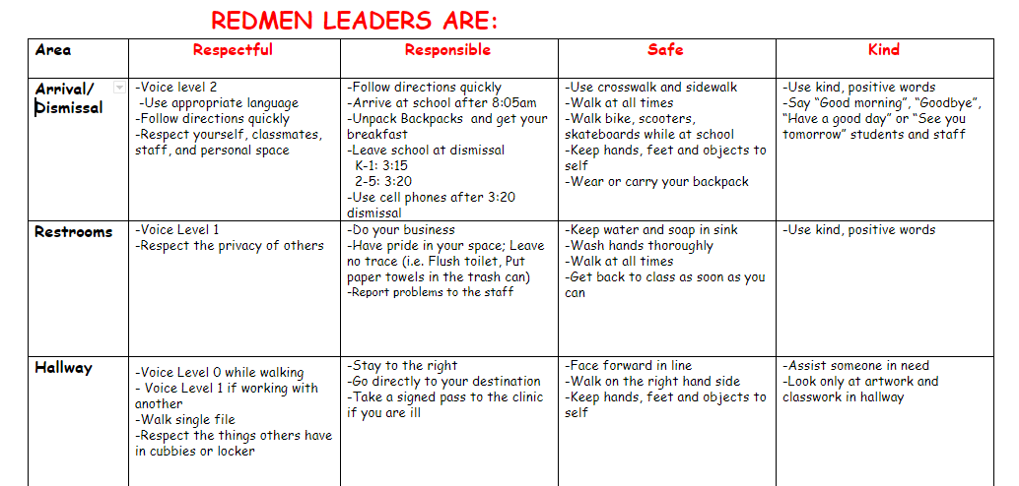

Slide 9
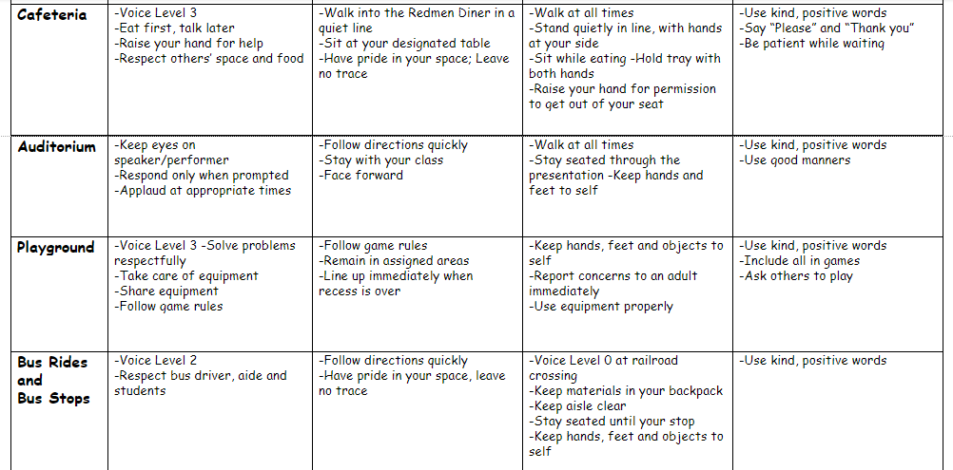

Slide 11
The following slides are just EXAMPLES.

Slide 12
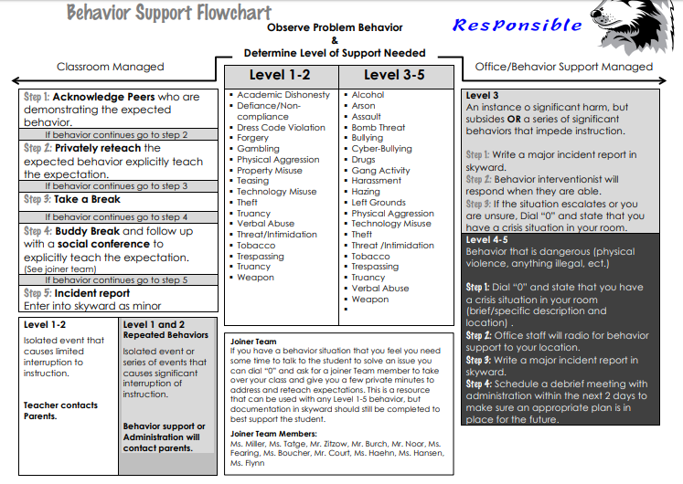

Slide 13
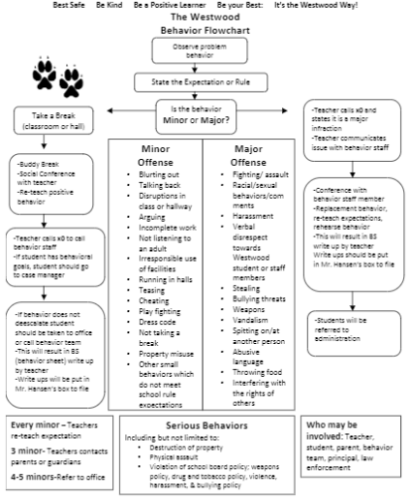

Slide 14
Good Behavior Acknowledgements
Acknowledgements for Good Behaviors:
Rewards
Praise
Shout-outs
Attendance at special events

Slide 15
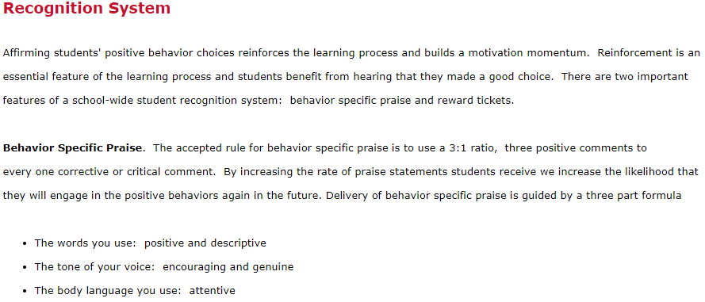

Slide 16
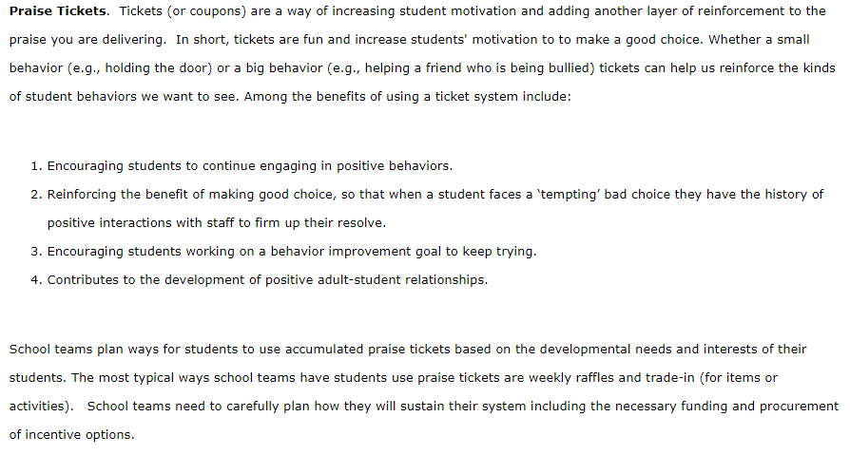

Slide 17
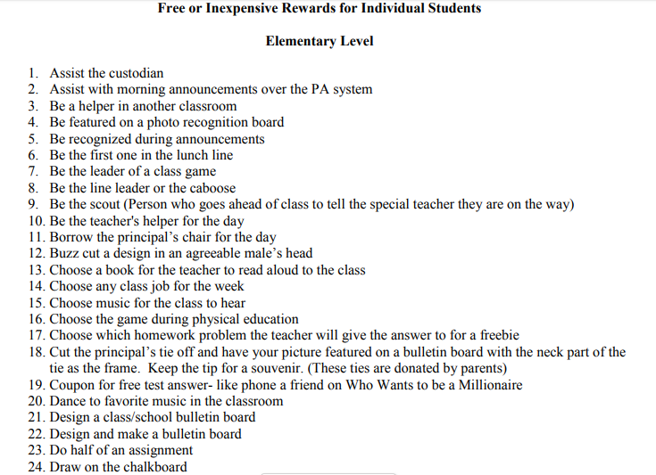

Slide 18
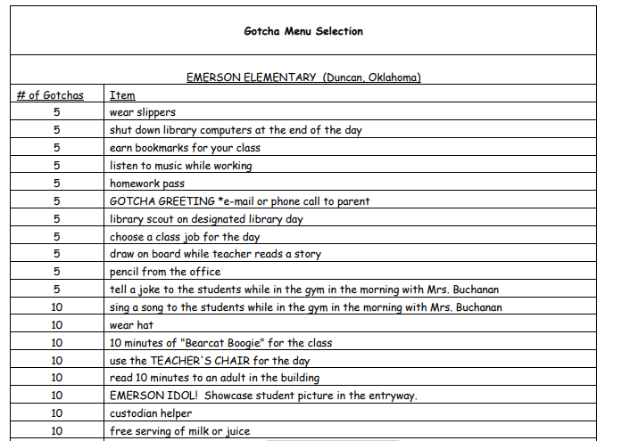

Slide 19
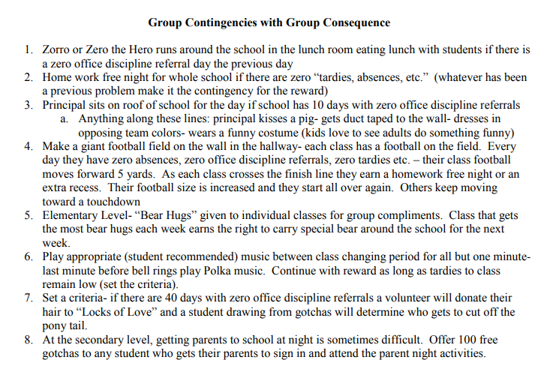

Slide 20
Consequences
PBIS in not void of consequences. It uses natural consequences and logical consequences as opposed to punishments.

Slide 21
The purpose of consequences is to change student behavior. If student behavior does not change, then the consequence is not effective.
Use of consequences can be somewhat fluid from student to student. A specific consequence may work for one student but not another.

Slide 22
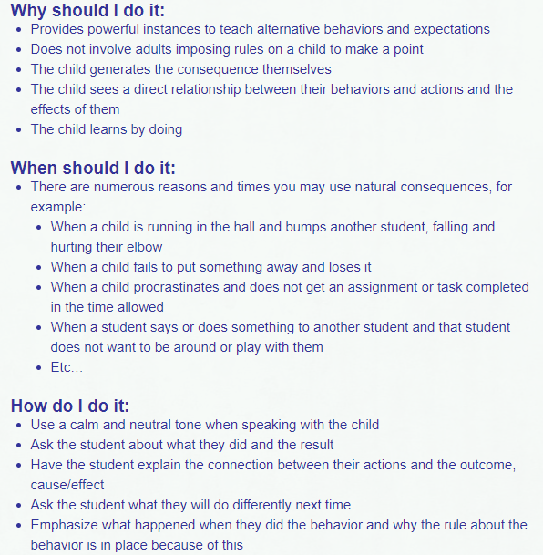
Natural Consequences:

Slide 23
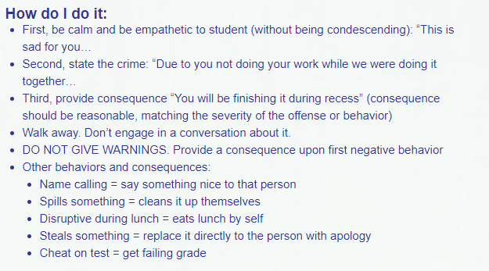
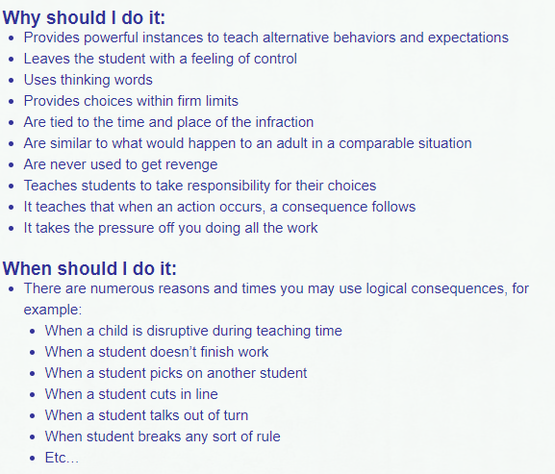
Logical Consequences:

