Slide 1
Improving Literacy Scores at Bucyrus Elementary
Vocabulary Focus

Slide 2
Overview of This Project
Aligns to Bucyrus City Schools OIP Plan
Uses student data to make adjustments
Includes professional development
Incorporates family engagement
Utilizes formative assessments to inform decisions
Compiles summative data to determine effectiveness

Slide 3
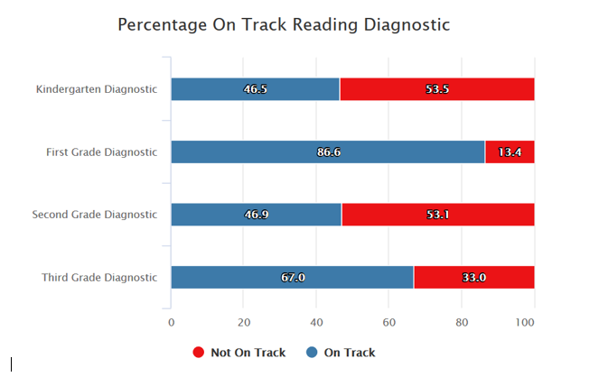
Determining the area of need through Reading Diagnostics

Slide 4
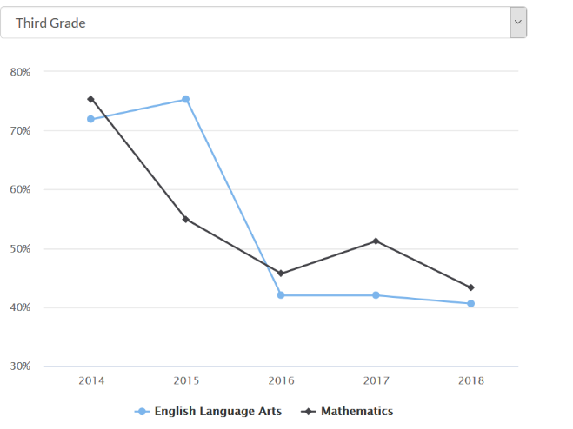
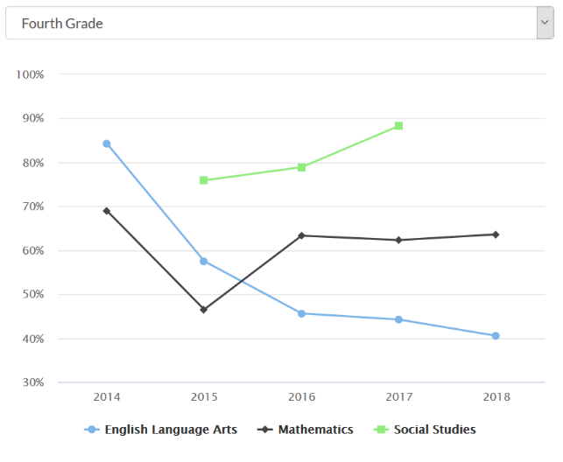
Determining the area of need through trend data

Slide 5
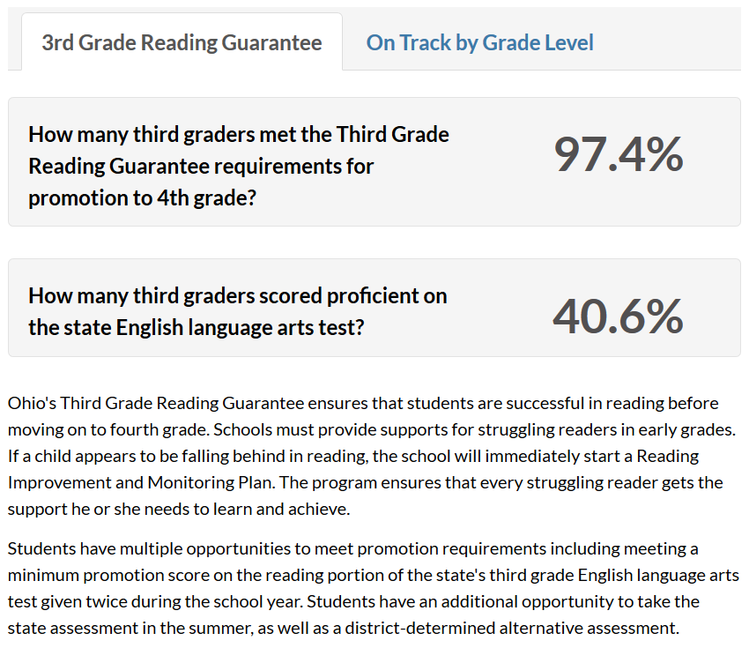
Determining the area of need through proficiency

Slide 6
Determining the area of need through analysis of state test questions
Analysis of 2017-2018 State Report Card Released Test Questions:
Types of questions needing focus:
Those about or containing vocabulary
Those about of containing compare and contrast

Slide 7
SMART Goal
By May 2019, Bucyrus Elementary School 2nd grade students will show an increase of 10% annually through explicit instruction in reading, especially related to vocabulary as measured by reading diagnostics and reported on the state report card.

Slide 8
District Goal
Alignment to District & School Goals
(a) Embedding students in the Integrated Comprehensive Services (ICS) model
(b) Increasing the performance index score.
School Goal
3rd, 4th, and 5th grade students will increase from an average of 38% achievement in reading to 58% achievement in reading as measured by the American Institute of Research (AIR) test.” (This is an increase in the Performance Index.)

Slide 9
Evidence-Based Strategies
Explicit Instruction
(Word of the Week)
Word Learning Strategies
Interactive Read Alouds
Frequency of Exposure

Slide 10
Types of Formative Assessment Used
 | Formative Assessments
 | NWEA Map Testing (F, W, Sp)
 | Graphic Organizers
 | Classroom Observation

Slide 11
Formative Assessment Adjustments
Groups after fall assessment
Groups after winter assessment
Group 1
Student A, Student B, Student C, Student D
Group 2
Student E, Student F, Student G, Student H, Student I
Group 3
Student J, Student K, Student L, Student M
Group 4
Group 5
Student N, Student O, Student P
Group 6
Student Q, Student R, Student S
Student T, Student U
Group 1
Student A, Student B, Student C, Student I
Group 2
Student C, Student F, Student H, Student M
Group 3
Student E, Student G, Student J, Student K
Group 4
Group 5
Student L, Student O, Student P, Student S
Student N, Student Q, Student R, Student T, Student U

Slide 12
Summative Evaluation
State Grade Cards will not be released until next fall.
Can’t yet make final determination about if “2nd grade students will show an increase of 10% annually through explicit instruction in reading, especially related to vocabulary”
So…will use NWEA test results to make a projection of student growth.

Slide 13
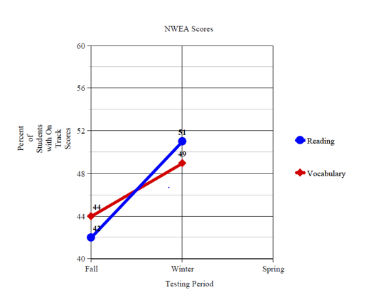
Summative Evaluation: On-Track Students According to NWEA

Slide 14
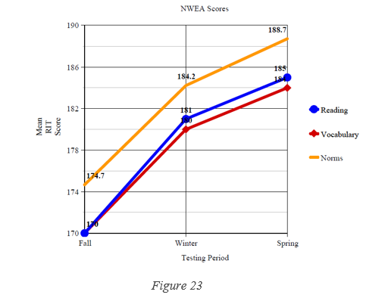
Summative Evaluation Projection using NWEA Scores

Slide 15
Successes
Most teachers: Very cooperative in implementing the needed strategies
Administrators: Supportive of the project as it was part of our school’s official OIP Plan
Students: Looked forward to the Words of the Week and the books that went along with them
Myself: Feel more confident in school wide implementation projects

Slide 16
Challenges
Wrapping my head around the project at the onset
Maintaining stamina for the duration
Some resistant teachers
Implementation of this project while teaching and completing other coursework
Data analysis

Slide 17
Overall Student Impact
Likely to make expected gains in student achievement in vocabulary according to NWEA projected scores.
Likely to achieve10% gain on reading diagnostics as reported by the state report card.

