Slide 1
Contrast: How Animals Survive the Winter
Brrrr. Winter is cold in some places. Many plants do not grow during winter. Some plants die. Snow and ice may cover the ground. It can be hard for animals to find food during winter. Animals get through this time in many ways. We can contrast how these animals survive during the winter.
Birds and butterflies can fly. Many of them do not stick around for the winter. They leave. They go to a place with nice weather. Then they come home in the spring. We call this migration. Migrating is a good way to avoid the cold.
Then again, another good way to avoid the cold is to sleep through it. Many animals hide during the winter. Their bodies slow down. They save their energy. They do not eat. They live off oftheir fat. They do this until food returns. We call this hibernation. Snakes, frogs, and bears hibernate.
Instead, some animals do not sleep all winter, but they do much less. They hide and store food in their homes. They live on what they saved in the summer and fall. This is what squirrels, beavers, and raccoons do. Skunks do this, too.
Unlike these animals, other animals tough it out. They do not leave. They do not hide. They must survive. Sometimes nature helps them out. Some animals grow thicker coats in the winter. Other animals change color. The arctic fox is brown in the summer. His coat turns white in the winter.
Can you contrast how animals survive the winter with how people survive the winter? How do you beat the winter? Do you wear a thick coat? Do you stay inside? Or do you live somewhere warm?

Slide 2
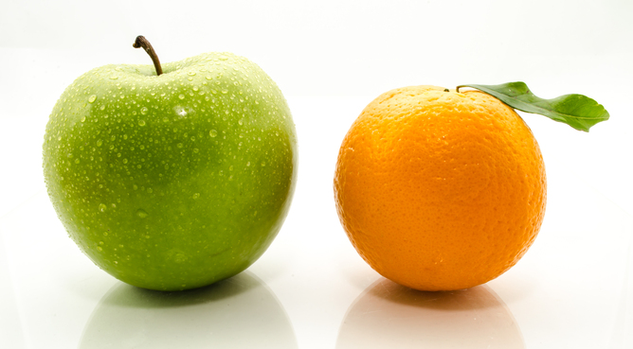
Contrast
To find differences

Slide 3
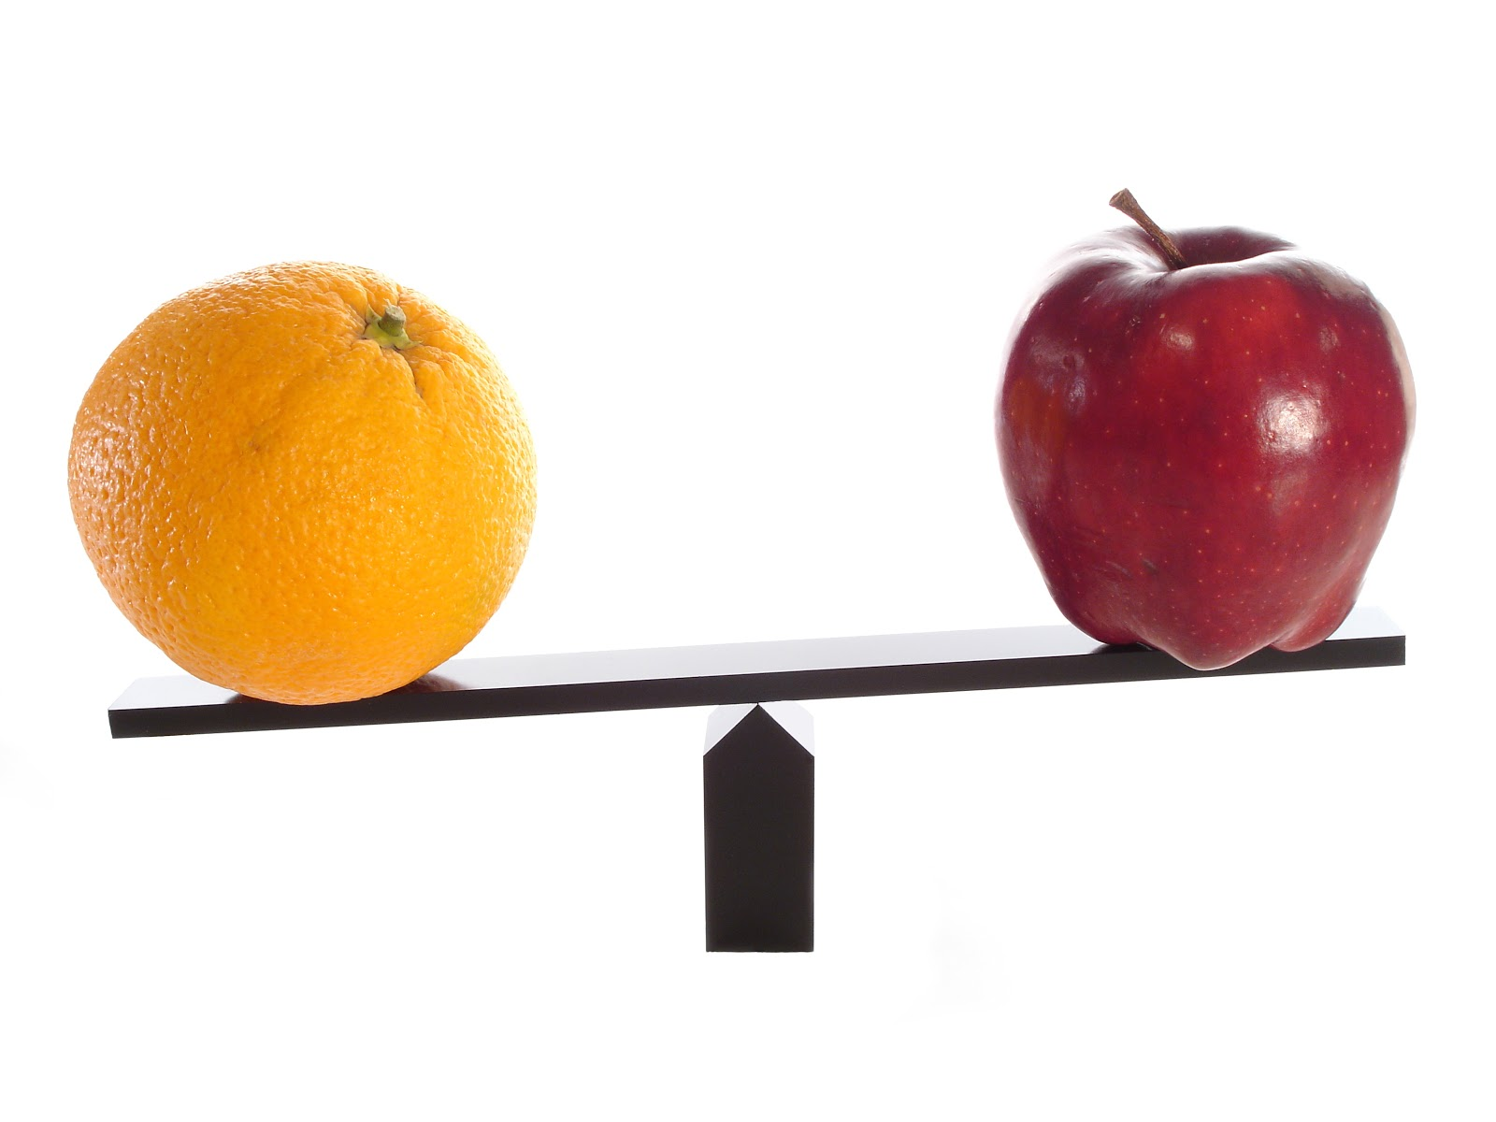
Contrast
What are some words that show us that two things are being contrasted?
Turn and Talk

Slide 4
Words that point to CONTRAST
Although
But
Instead
In contrast
Then again
Unlike
Yet
Even though
However
Rather

Slide 5
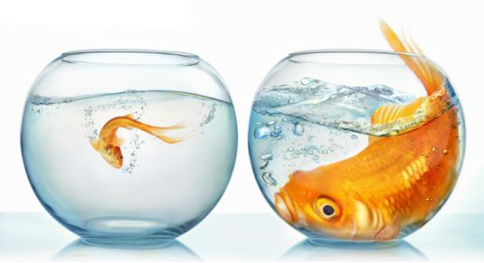
Use the word
CONTRAST
in a sentence.
Use the picture to help you.
Turn and Talk

Slide 6
Can you think of a time that you had to CONTRAST two things?
Turn and Talk.

