Slide 1
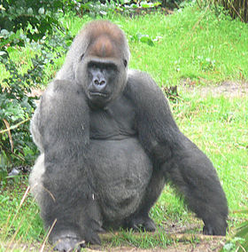
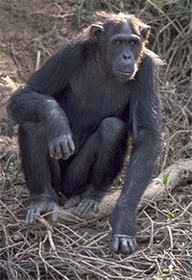
Gorillas and Chimpanzees
Gorillas and chimpanzees have many characteristics that we can compare. They have physical similarities as well as behaviors in common. Both are primates. This means that their genetic makeup is very much alike. Additionally, these primates are similar in height. Adult male gorillas and chimps are both generally 5 feet tall. Another physical similarity is that these primates have opposable digits on both the hands and feet. This similarity leads to a common behavior. Because these digits make the primates able to hold objects, gorillas and chimps can provide shelter for their families. Chimps use their hands to collect twigs and leaves to create soft nests in trees for their family groups. Likewise, female and baby gorillas also sleep in trees in homemade twig nests. Diet is another similarity between the two primate groups. Also, like chimps, gorillas prefer a diet of fruit, nuts and vegetables.
Gorillas and Chimpanzees

Slide 2
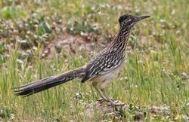
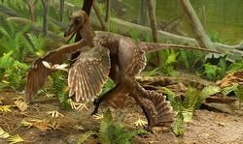
Birds and Dinosaurs
Did you know one kind of dinosaur still survives? Birds! We know that birds are a kind of dinosaur because birds and extinct dinosaurs are alike in lots of ways.
Compare the two animals in the pictures below. Sinornithosaurus (sigh-NOR-nith-oh-sawr-us) is a dinosaur that lived long ago. The roadrunner is a bird living today. Both animals walk and run on two legs. They are similar in other ways too. They both have claws, and their bodies are covered with feathers.
Roadrunners are birds living today.
A photographer took this picture of a roadrunner in a field.
No one has ever seen a living Sinornithosaurus. This is a photograph of a model that was made by an artist.

Slide 3
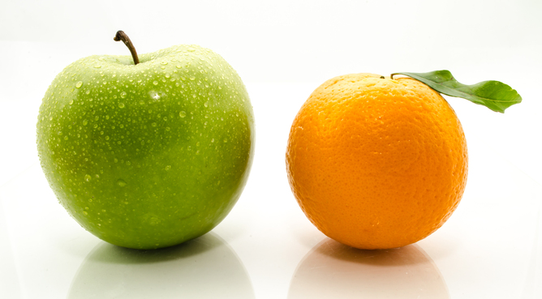
Compare
To find likenesses

Slide 4
Compare
What are some words that show us that two things are being compared?
Turn and Talk

Slide 5
Words that point to COMPARE
Like
Alike
And
Common
Likewise
Similar
Both
As well as

Slide 6
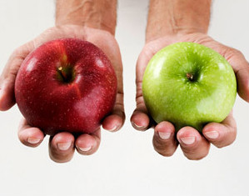
Use the word
COMPARE
in a sentence.
Use the picture to help you.
Turn and Talk

Slide 7
Can you think of a time that you had to COMPARE two things?
Turn and Talk.

